Slide 1
Building High Assurance Software without Breaking the Bank
Yannick Moy, SPARK Product Manager, AdaCore
Rod Chapman, Director, Protean Code Ltd.

Slide 2
Why it matters to know your software?
Pervasive
Security
Attacks
Complex
Requirements

Slide 3
What we would like to know about software
At a minimum
Software does not ‟blow up”
Always
Defect density is very low (zero?)
Ideally
Important safety / security properties are enforced

Slide 4
What do you know about your software?
Number of lines of code
Cyclomatic complexity
Coding standard violations
Flow of control
Flow of information
Proper data initialization
Defect density
Absence of run-time errors
Safety/security properties

Slide 5
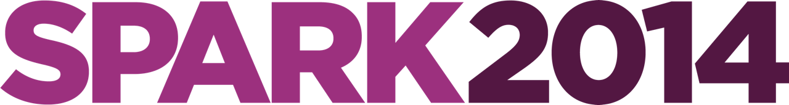
How SPARK and formal verification can help
Number of lines of code
Cyclomatic complexity
Coding standard violations
Light static analysis
Deep static analysis
Flow of control
Flow of information
Proper data initialization
Formal verification
Defect density
Absence of run-time errors
Safety/security properties

Slide 6
Formal verification in SPARK
Benefits
Correct initialization
Correct data dependencies
Safe concurrent access
control flow graph (CFG)
Benefits
Absence of run-time errors
Functional contracts proved
Safety/security properties
∃x. P(x) ⟹
¬∀x. ¬ P(x)
verification conditions (VC)

Slide 7
Formal verification levels
circle size = size of code
Correct
initialization
and data dependencies
Strong coding standard
Absence of run-time errors
Stone
Bronze
Safety and
security
properties
Silver
Gold

Slide 8
Stone level: strong coding standard
SPARK | MISRA C
Strong rich typing inherited from Ada | MISRA C essential type
Absence of side-effects in expressions | MISRA C persistent side effects
Pointers, dynamic allocation and aliasing isolated in non-SPARK code (but addresses and references are ok) | MISRA C restrictions on pointers and dynamic allocation
Safe concurrency through language mechanisms

Slide 9
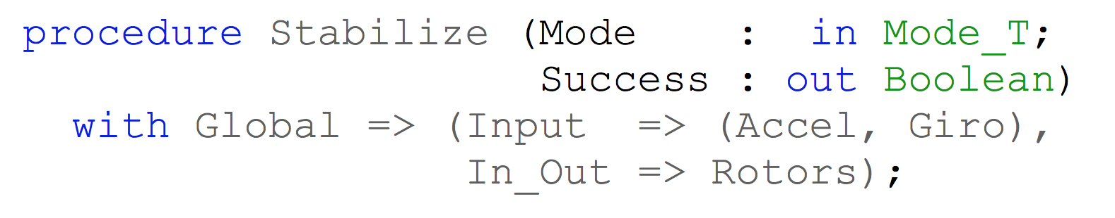
Bronze level: know your data
Global variables are evil… unless known with SPARK
Any mismatch between contract and code is detected (maintenance)
Parameter and global modes (in/out/in out) support modular analysis of data initialization

Slide 10
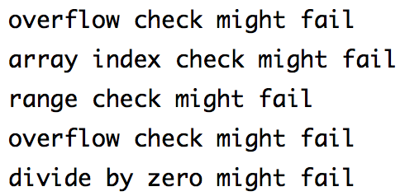
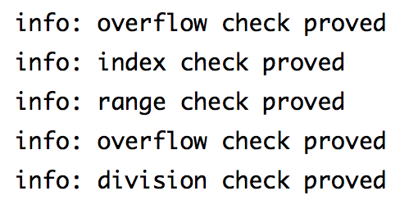
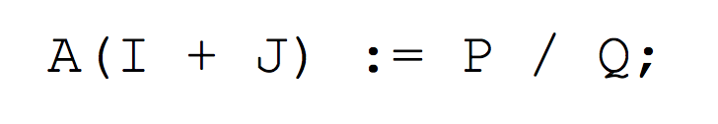
Silver level: control your software
Run-time errors are evil… unless eliminated with SPARK
Even safety/security focused code reviews miss critical vulnerabilities
Only tool-supported analysis can achieve 100% guarantees

Slide 11
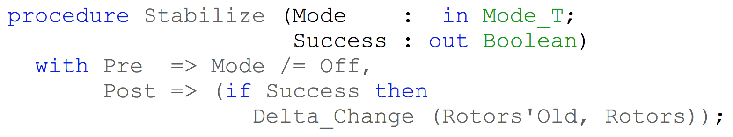
Gold level: know your software
Contracts on functions specify intended behavior
Alternative to comments, defensive code, informally specified requirements
Contracts can be executed (tests) and stripped in final executable
Contracts can be proved (analysis) in minutes on developers’ machines

Slide 12
The path to adoption
The first project
Target small project
Ideally new project or partial rewrite
Stone/Bronze levels
Moving up levels
Maximize use of SPARK (Stone)
Prove all code safe (Bronze/Silver)
Prove only critical properties (Gold)
Scaling it
Build up expertise through training of selected engineers
Analysis used by developers on their machine (agile!)

Slide 13
Examples of industrial practice with SPARK
Standard | DO-178, DEFSTAN 00-55 | CAP670 SW01 | Common Criteria GCHQ Standards
Certification level | DO-178 level A, DEFSTAN SIL4 |  | NSA Type 1 Secret
Typical analysis level | Bronze/Silver/Gold | Silver | Silver/Gold
Some projects | Typhoon, SHOLIS, C130J | iFACTS | Turnstile, Muen, MLW
Some customers | Rolls-Royce, Lockheed Martin | NATS | Rockwell Collins, Secunet, MBDA

Slide 14
SPARK in Avionics & Defence
SHOLIS:
DEFSTAN 00-55 SIL4
First Gold
Typhoon:
Bronze (with Silver for a few systems)
C130J:
Bronze (Lockheed Martin) and Gold (UK RAF and BAE Systems)

Slide 15
SPARK in Air Traffic Management
Almost all code in SPARK (250 kloc)
153,000 proofs of which 98.76% fully automatic. User input and reviews for the rest.
Overnight proof from scratch: 2 hours
Developers reprove the whole thing in 15 minutes using a cache
Small change? A few seconds… (pre-commit)
NATS iFACTS:
Silver (but really big…)

Slide 16
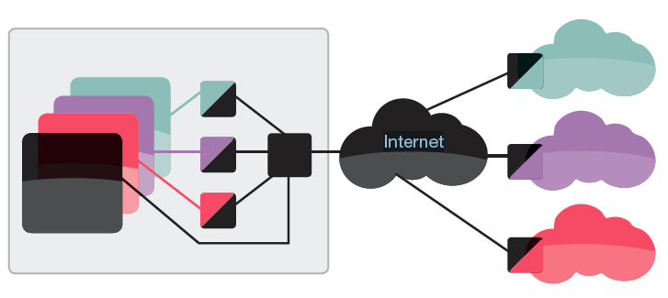

SPARK in Security
Rockwell Collins Turnstile/SecureOne: cross-domain switch
Silver and Gold
Secunet MLW:
multilevel workstation
Silver and Gold (for encryption-related properties)
MBDA EISR:
secure in-the-field updating with code-signing
Silver

Slide 17
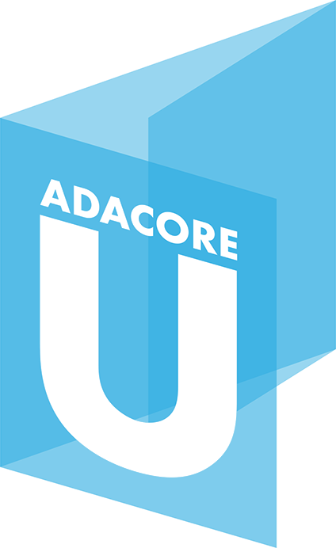
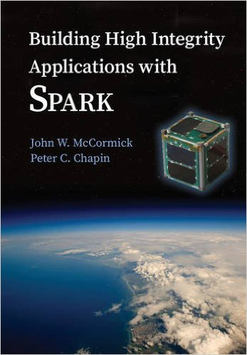
Learning SPARK
Free e-learning course on AdaCore University
http://u.adacore.com/
Online SPARK User’s Guide:
Tutorials and How to’s
Large set of examples
SPARK Book by McCormick & Chapin
3-days & 5-days training by AdaCore and Altran

Slide 18
Comparison between SPARK and MISRA C
Mostly comparable at Stone level (strong coding standard)
MISRA C rules catch some typing violations and some conflicts of side effects
SPARK rules enforce strong typing and control of side effects
SPARK guarantees at Bronze/Silver levels
are undecidable rules in MISRA C (not enforced)
Rule 1.3 ‟no occurrence of undefined [..] behavior”
Rule 9.1 ‟an object [..] shall not be read before it has been set ”
SPARK Gold level is outside of the scope of MISRA C

Slide 19
Myth Buster: This is not for software engineers
Tools are integrated in development environments, mostly automatic, fast and interactive
Typical pick-up time varies depending on level:
1 week for Stone/Bronze levels (mostly Ada)
8 weeks for Silver level
a few months for Gold level
Data: Altran trained hundreds of engineers to use SPARK over the years. iFACTS trained over 60 developers across 3 continents, including both permanent staff and contractors. It worked.

Slide 20
Myth Buster: It is going to cost too much
Upfront investment is required, but…
SPARK strongly decreases pre-test defect density
Strongly correlated with cost overrun (SEI data)
Defects detected later cost much more
SPARK analysis can be used to replace other activities
Can replace low-level testing (for example with avionics standard DO-178C)
Can replace some review activities
Data: Lockheed Martin cited only spending 20% of the Level A Test budget on the C130J Mission Computer, saving 80% of a very big number!

Slide 21
Myth Buster: It does not work in my environment
SPARK development environment available for Windows, Linux, Mac
SPARK cross-compilation to ARM, PowerPC, Leon, either bare metal or with OS (Linux, VxWorks, LynxOS, PikeOS)
No compiler for your environment? (e.g. AVR, Renesas)
Use SPARK-to-C compiler!
SPARK interoperable with Ada, C, C++, Java
Data: Mixed-language development is the norm with SPARK, not the exception

Slide 22
Links
E-learning website: http://u.adacore.com/
Professional version: http://www.adacore.com/sparkpro/
Community version: http://libre.adacore.com/
Portal for information and resources: http://www.spark-2014.org/
Contact: sales@adacore.com

